Slide 2

Applied Algorithm Lab
CBUS

Slide 3
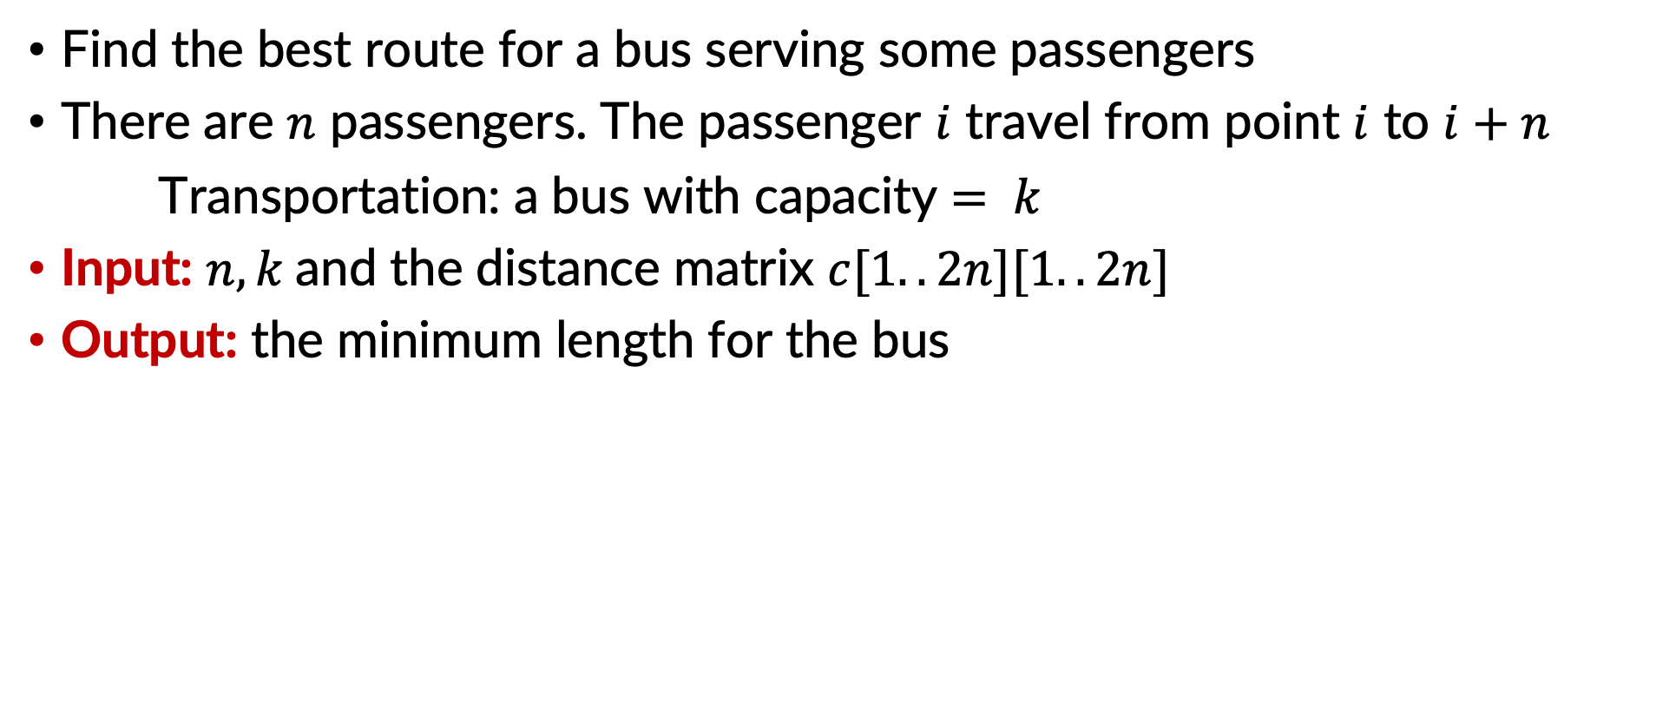
CBUS
Find the best route for a bus serving some passengers
There are $n$ passengers. The passenger $i$ travel from point $i$ to $i+n$
Transportation: a bus with capacity $= k$
Input: $n, k$and the distance matrix $c[1..2n][1..2n]$
Output: the minimum length for the bus

Slide 4
CBUS
Example
stdin | stdout
3 2 0 8 5 1 10 5 9 9 0 5 6 6 2 8 2 2 0 3 8 7 2 5 3 4 0 3 2 7 9 6 8 7 0 9 10 3 8 10 6 5 0 2 3 4 4 5 2 2 0 | 25

Slide 5
CBUS
Idea to solve: backtracking and branch & bound, similar to TSP
An array x[1..2n] - permutation of 1,…,2n representing the locations of our bus
Supporting variables:
Marking array: appear[1..2n]
appear[v] = true means that v has appear in the route.
load: number of passengers in the bus
Programming:
Try(k): select value for x[k]
Branch and bound: similar to the solution of TSP

Slide 6
THANK YOU !

